Slide 1

Impact of Car Features

Slide 2

PROJECT DESCRIPTION
This project aims to analyze a dataset containing loan application information to identify patterns and trends influencing loan repayment behavior. The goal is to construct a predictive model capable of assessing creditworthiness and informing loan approval decisions. Data cleaning and preprocessing steps, including handling missing values and outliers, were performed to ensure data quality.
Key Components:
Data Acquisition: Obtaining and consolidating loan application data.
Data Preparation: Cleaning and preprocessing the data to remove inconsistencies and improve data quality.
Exploratory Data Analysis (EDA): Utilizing statistical techniques and visualizations to understand data characteristics and relationships.
Model Development: Building predictive models to classify loan applicants as high or low risk.
Model Evaluation: Assessing model performance and generating actionable insights.

Slide 3

DATASET DESCRIPTION
The variables in the dataset are:
Make: the make or brand of the car
Model: the specific model of the car
Year: the year the car was released
Engine Fuel Type: the type of fuel used by the car (gasoline, diesel, etc.)
Engine HP: the horsepower of the car's engine
Engine Cylinders: the number of cylinders in the car's engine
Transmission Type: the type of transmission (automatic or manual)
Driven_Wheels: the type of wheels driven by the car (front, rear, all)
Number of Doors: the number of doors the car has
Market Category: the market category the car belongs to (Luxury, Performance, etc.)
Vehicle Size: the size of the car
Vehicle Style: the style of the car (Sedan, Coupe, etc.)
Highway MPG: the estimated miles per gallon the car gets on the highway
City MPG: the estimated miles per gallon the car gets in the city
Popularity: a ranking of the popularity of the car (based on the number of times it has been viewed on Edmunds.com)
MSRP: the manufacturer's suggested retail price of the car

Slide 4

TECH STACK USED
I have used MS Office LTSC Professional Plus 2021 version for my project -
MS Excel:
Numerical Data: Storing and manipulating numbers, performing calculations using formulas and functions, and creating financial models.
Data Tables and Charts: Organizing large datasets into rows and columns, and generating various charts and graphs to visually represent trends and patterns.
Data Analysis Tools: Offering features like pivot tables for summarizing data, sorting and filtering for focused analysis, and conditional formatting for highlighting important information.
MS PowerPoint:
Slide Creation: Build compelling presentations using a variety of layouts for text, images, charts, and graphs.
Visual Storytelling: Enhance your message with multimedia elements like pictures, videos, and sound effects, bringing your presentation to life.
Customization: Tailor your presentation to your audience and brand with a wide range of design themes, fonts, and color schemes.
Delivery Tools: Projector support, presenter notes, and speaker view with a countdown timer empower you to deliver a confident and engaging presentation.

Slide 5

PROJECT APPROACH
The project commenced with a rigorous data exploration phase, employing descriptive statistical methods and data visualization techniques to uncover underlying patterns and trends within the loan dataset. To ensure data quality and reliability, missing values were imputed, and outliers were carefully examined and addressed.
Subsequently, the focus shifted towards building predictive models to assess loan default risk. A variety of statistical and machine learning algorithms, including regression analysis, decision trees, and potentially more sophisticated models, will be considered and evaluated based on their performance metrics. Feature engineering techniques will be employed to create new variables that enhance the predictive power of the model.
Throughout the project, a meticulous approach to data cleaning, exploration, and modeling will be maintained to ensure the robustness and reliability of the findings.

Slide 6

DATA CLEANING
Data Cleaning Steps:
Identifying Null Values: You correctly used COUNTBLANK to identify the percentage of null values in your dataset.
Handling Numerical Missing Values: Imputing the median for Engine HP, Engine Cylinders, and Number of Doors is a reasonable approach when dealing with numerical data, especially if the distribution is relatively symmetric.
Handling Categorical Missing Values: Deleting rows with missing Engine Fuel Type values is a straightforward method when there's no clear way to impute or categorize them. However, it might lead to data loss if the missing values are significant.
Addressing Data Type Inconsistencies: Identifying and removing rows with incorrect data types (dates in the Model column) is crucial for data integrity.
Potential Improvements and Considerations:
While your approach is effective, there are some areas where you could potentially refine your process:
Alternative to Deleting Rows:
For Engine Fuel Type, consider creating a category like "Unknown" or "Other" for missing values instead of deleting entire rows.
For the Model column, if the number of rows with date values is relatively small, you could potentially create a new category like "Invalid Model" instead of deleting them.
Exploring Other Imputation Methods:
Depending on the distribution of your data and the nature of missing values, you might explore other imputation methods like mean, mode, or more sophisticated techniques like K-Nearest Neighbors or multiple imputation.
Root Cause Analysis:
Understanding why certain columns have missing values or incorrect data types can help prevent similar issues in the future. Investigating the data collection process or sources might provide valuable insights.
Data Visualization:
Creating visualizations of your data before and after cleaning can help you identify patterns, outliers, and potential issues that might have been overlooked.

Slide 7

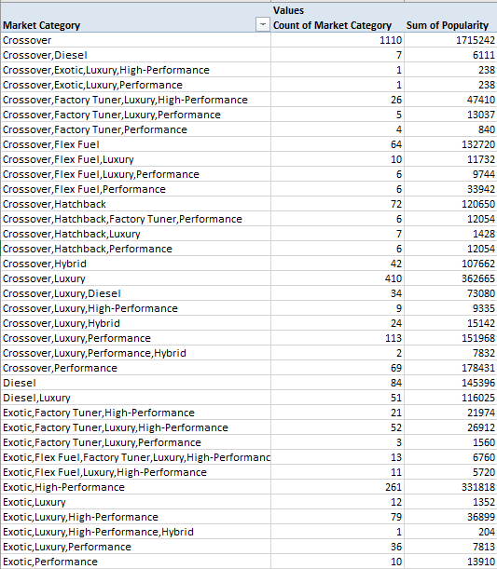
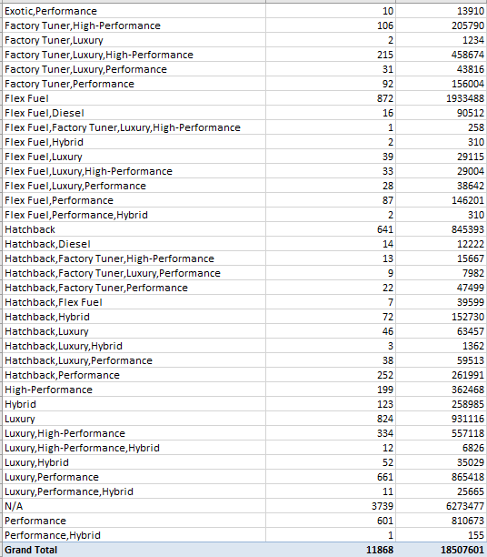
TASKS : ANALYSIS
Insight Required: How does the popularity of a car model vary across different market categories
Task 1.A: Create a pivot table that shows the number of car models in each market category and their corresponding popularity scores.

Slide 8
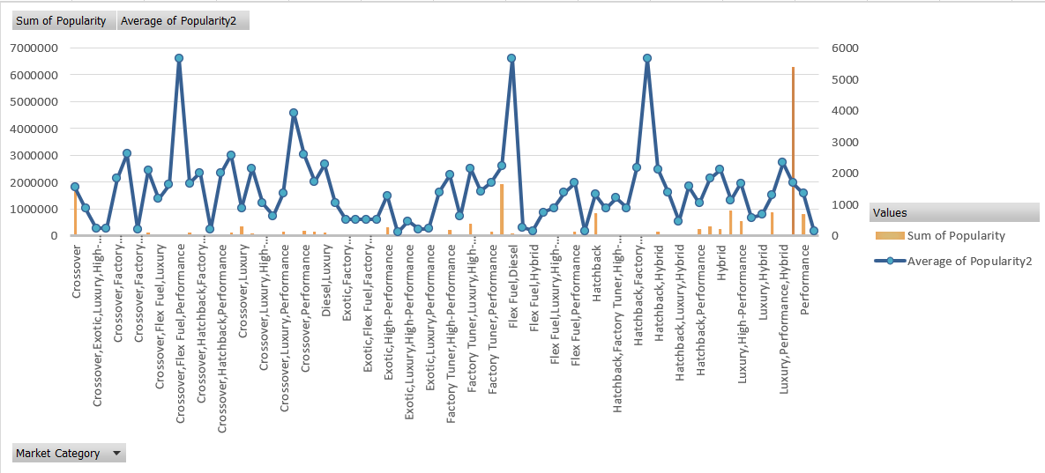
Task 1.B: Create a combo chart that visualizes the relationship between market category and popularity.

Slide 9
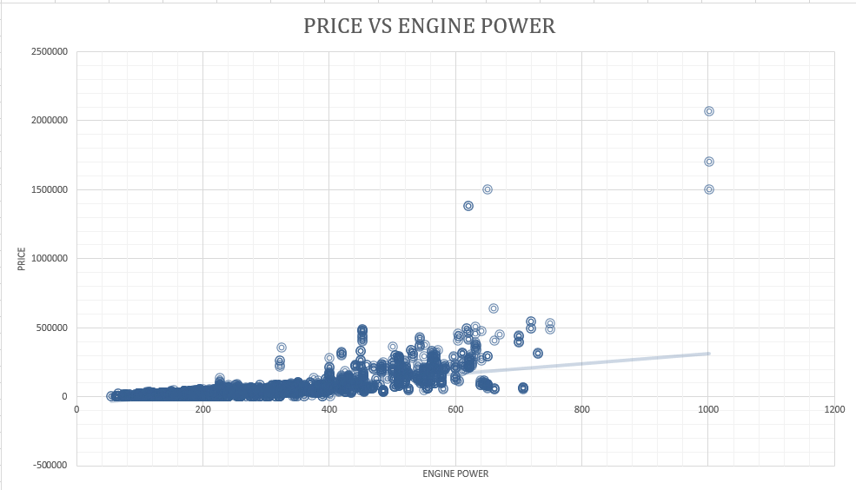
Insight Required: What is the relationship between a car's engine power and its price?
Task 2: Create a scatter chart that plots engine power on the x-axis and price on the y-axis. Add a trendline to the chart to visualize the relationship between these variables.

Slide 10
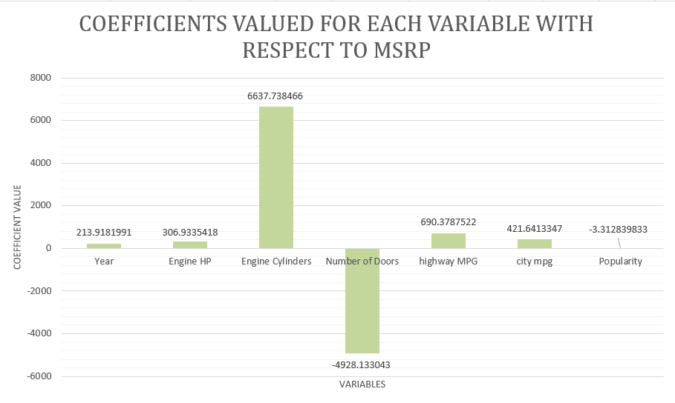
Insight Required: Which car features are most important in determining a car's price?
Task 3: Use regression analysis to identify the variables that have the strongest relationship with a car's price. Then create a bar chart that shows the coefficient values for each variable to visualize their relative importance.

Slide 11
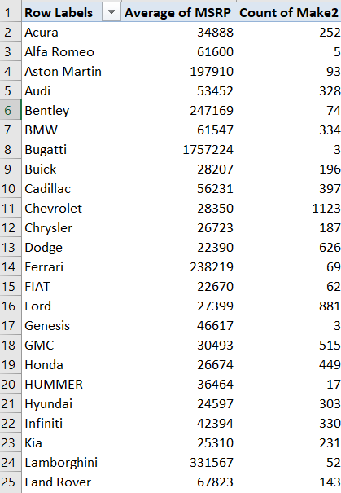
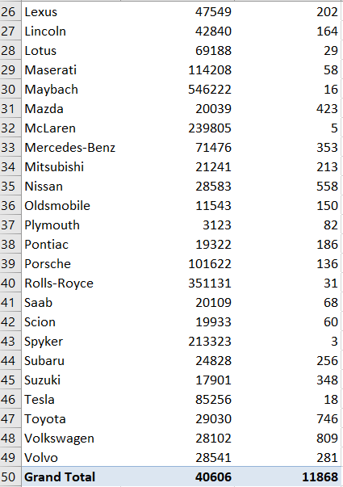
Insight Required: How does the average price of a car vary across different manufacturers?
Task 4.A: Create a pivot table that shows the average price of cars for each manufacturer.

Slide 12
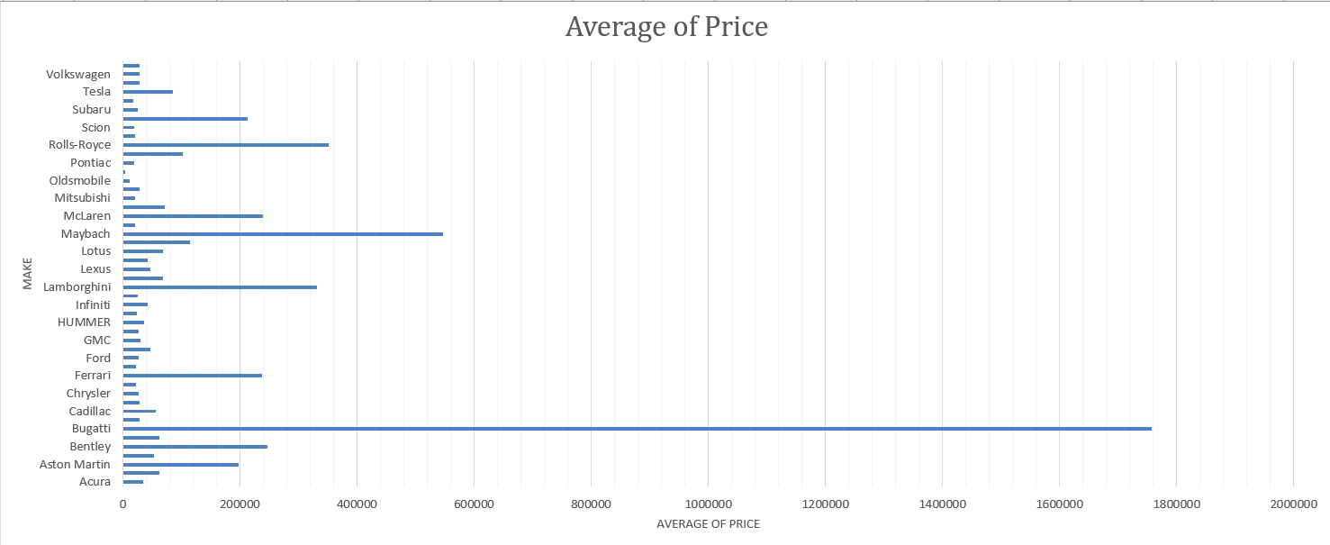
Task 4.B: Create a bar chart or a horizontal stacked bar chart that visualizes the relationship between manufacturer and average price.

Slide 13
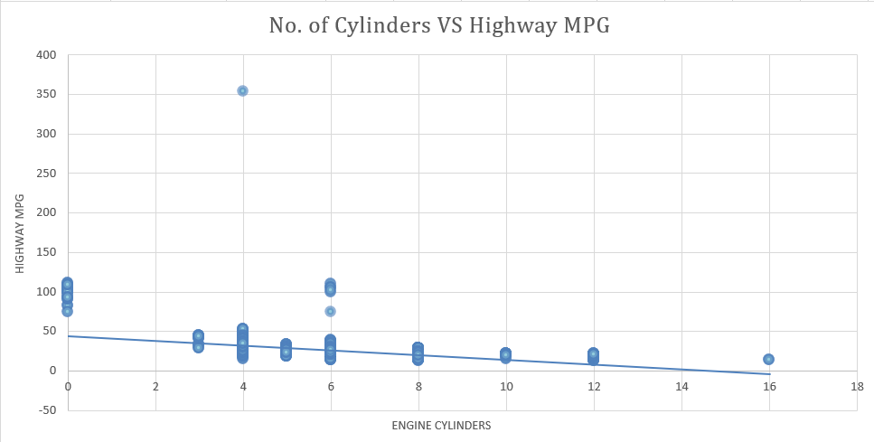
Insight Required: What is the relationship between fuel efficiency and the number of cylinders in a car's engine?
Task 5.A: Create a scatter plot with the number of cylinders on the x-axis and highway MPG on the y-axis. Then create a trendline on the scatter plot to visually estimate the slope of the relationship and assess its significance.

Slide 14
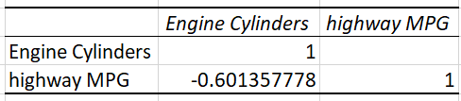
Task 5.B: Calculate the correlation coefficient between the number of cylinders and highway MPG to quantify the strength and direction of the relationship.

Slide 15

Answers to the Required Insights
TASK 1 - The analysis revealed a high frequency of "Not Applicable" entries within the Market Category variable. The most prevalent car category was identified as "Crossover," while "Hatchback Flex Fuel" exhibited the highest average popularity. In terms of overall popularity, the "Flex Fuel" category garnered the most significant sum.
TASK 2 - A positive correlation was observed between engine power and vehicle price. This indicates that as engine power increases, the corresponding vehicle price tends to rise. This relationship can be attributed to the increased costs associated with advanced technologies and performance enhancements required for higher engine power outputs. However, notable exceptions exist, exemplified by luxury brands such as Bugatti, Lamborghini, and Maybach, which command premium prices despite variations in engine power.
TASK 3 - To isolate numerical data for analysis, relevant columns were extracted and transferred to a separate worksheet. Regression analysis was employed to assess the correlation between MSRP and other numerical variables. Engine cylinders emerged as a key predictor of vehicle price, exhibiting a strong positive relationship. Conversely, the number of doors demonstrated a negligible impact on pricing.
TASK 4 - Bugatti stands out as a price outlier, commanding the highest average price within the dataset. This premium pricing is attributed to the brand's reputation for exclusivity, luxury, and high-performance engineering. However, it's important to note that the limited number of Bugatti models within the dataset (only three) might skew the average price and potentially overstate the brand's price leadership. A larger dataset would be required to draw more definitive conclusions.
TASK 5 - A negative correlation was observed between the number of engine cylinders and highway miles per gallon (MPG). This indicates that vehicles equipped with more cylinders tend to exhibit lower fuel efficiency. The resulting trendline demonstrates a downward slope, further solidifying the inverse relationship between these two variables.

Slide 16

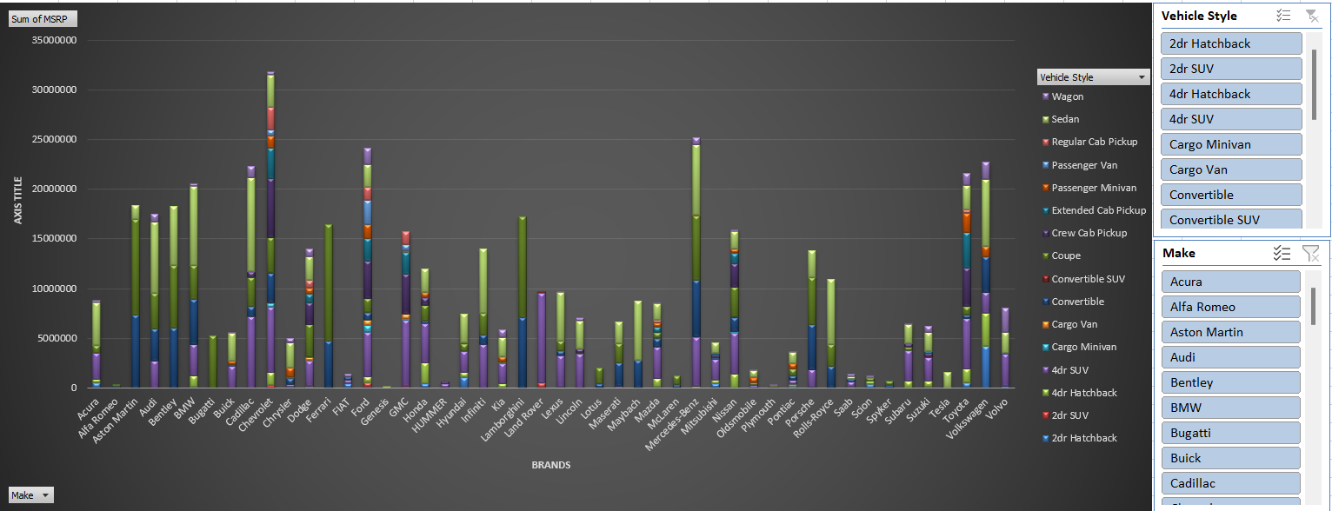
TASKS : DASHBOARD
Task 1: How does the distribution of car prices vary by brand and body style?
Hints: Stacked column chart to show the distribution of car prices by brand and body style. Use filters and slicers to make the chart interactive. Calculate the total MSRP for each brand and body style using SUMIF or Pivot Tables.

Slide 17

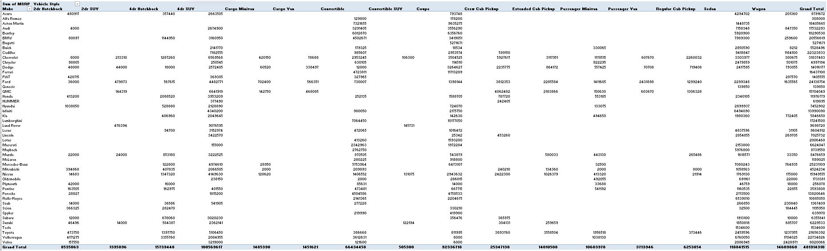
The analysis revealed distinct pricing patterns across different car brands and body styles. These insights can be leveraged by manufacturers to refine pricing strategies and enhance profitability. The interactive capabilities offered by slicers allow for granular exploration of the data, enabling a deeper understanding of market dynamics and consumer preferences.

Slide 18
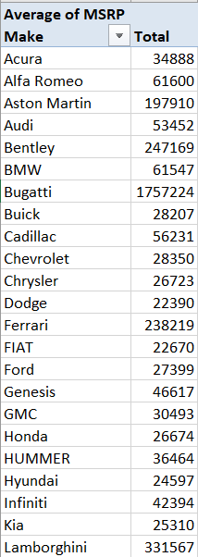
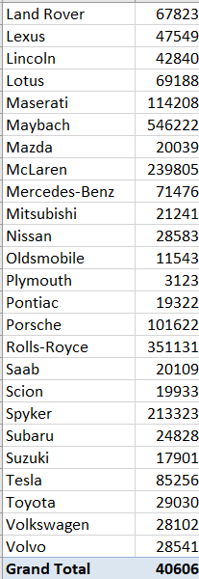
Task 2: Which car brands have the highest and lowest average MSRPs, and how does this vary by body style? Hints: Clustered column chart to compare the average MSRPs across different car brands and body styles. Calculate the average MSRP for each brand and body style using AVERAGEIF or Pivot Tables.

Slide 19
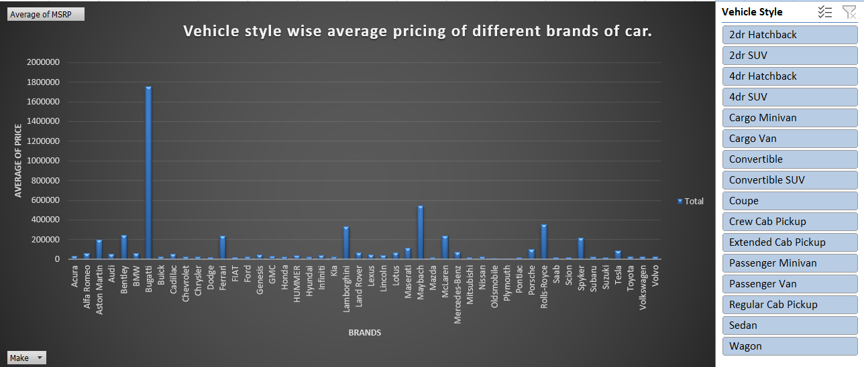
The analysis revealed distinct pricing variations among different automotive brands and vehicle styles. Luxury brands, exemplified by Bugatti, Maybach, and Lamborghini, commanded significantly higher average MSRPs compared to mainstream brands like BMW, Toyota, and Audi. Similarly, vehicle styles such as Sedans, 4-Door SUVs, and Coupes exhibited higher average MSRPs relative to other body types.

Slide 20
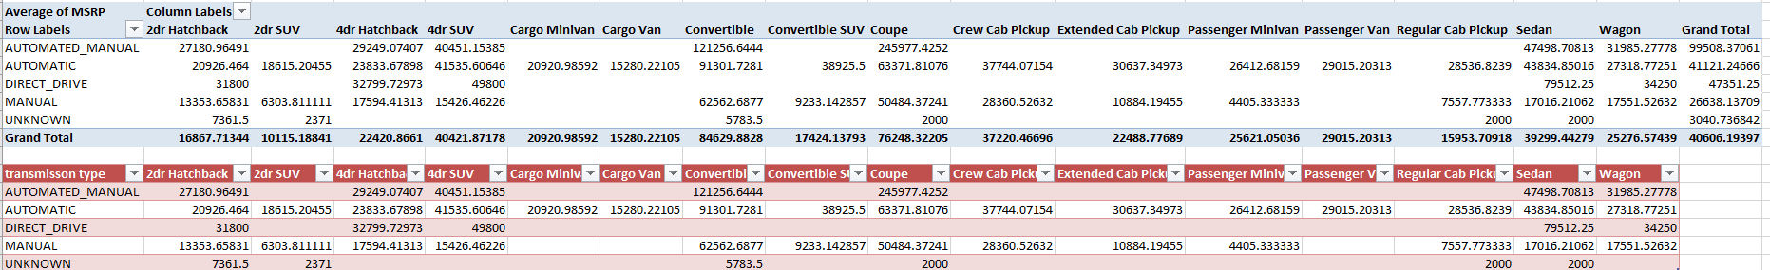
Task 3: How do the different feature such as transmission type affect the MSRP, and how does this vary by body style?
Hints: Scatter plot chart to visualize the relationship between MSRP and transmission type, with different symbols for each body style. Calculate the average MSRP for each combination of transmission type and body style using AVERAGEIFS or Pivot Tables.

Slide 21
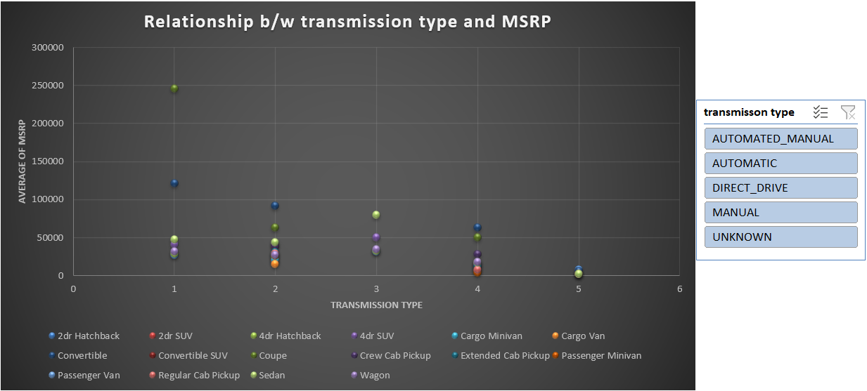
The Analysis shows the Relationship between Transmission Type and MSRP of cars. Bugatti emerged as the brand with the highest average MSRP, primarily attributed to its coupe body style. Maybach followed closely, offering both sedan and convertible options at premium price points. In contrast, Plymouth and Oldsmobile exhibited the lowest average MSRPs across their respective model lineups, irrespective of body style variations.

Slide 22
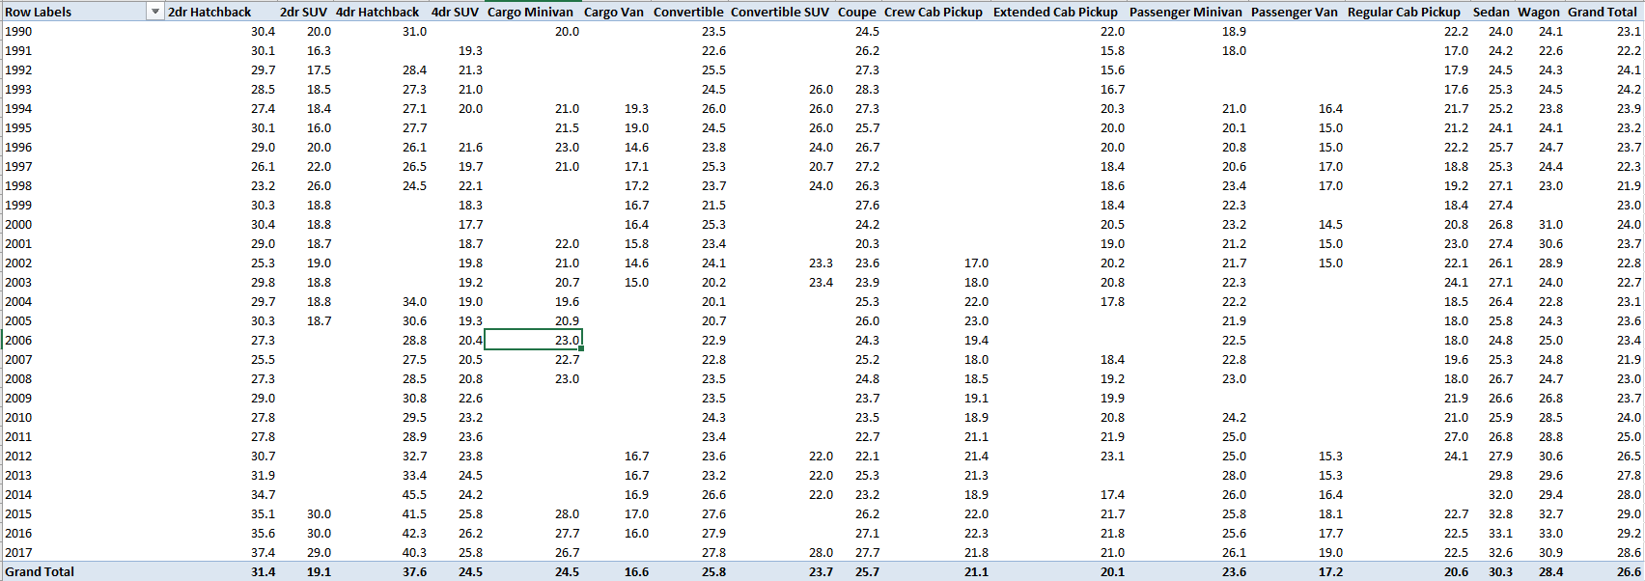
Task 4: How does the fuel efficiency of cars vary across different body styles and model years?
Hints: Line chart to show the trend of fuel efficiency (MPG) over time for each body style. Calculate the average MPG for each combination of body style and model year using AVERAGEIFS or Pivot Tables.

Slide 23
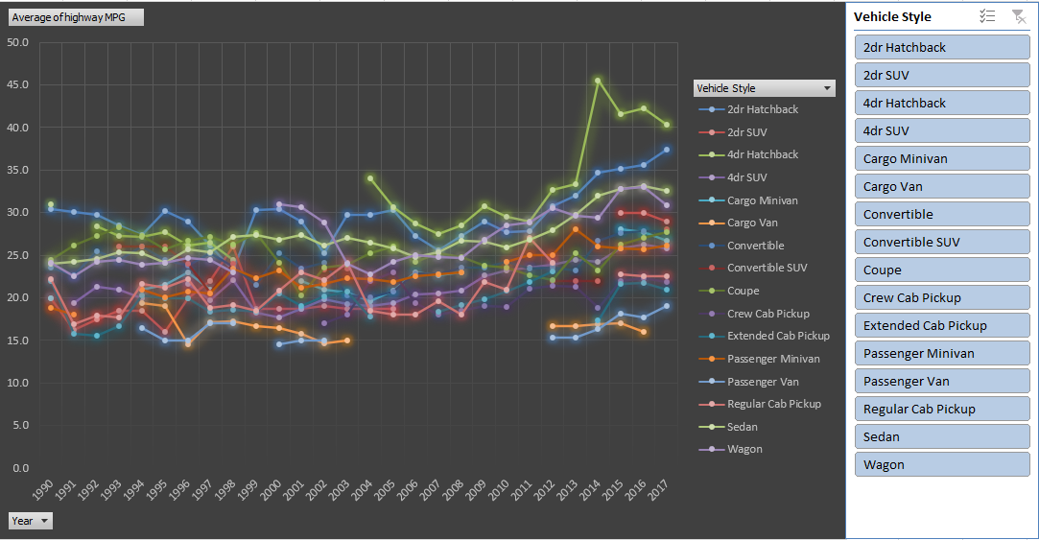
The analysis revealed notable trends in fuel efficiency across different body styles over time. Hatchback configurations, including 4-door and 2-door variants, demonstrated superior fuel economy compared to other body types.

Slide 24
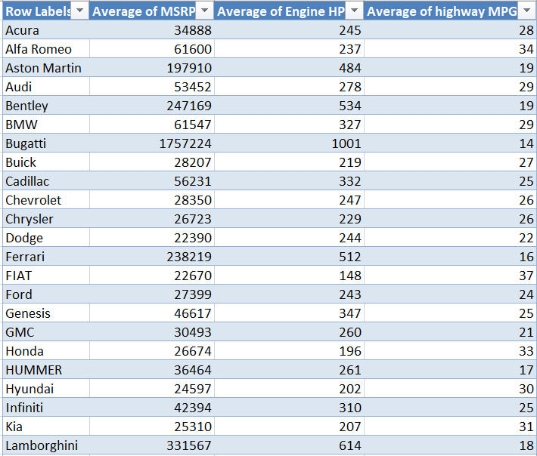
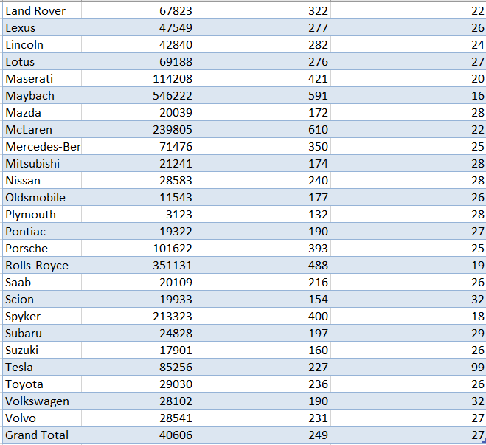
Task 5: How does the car's horsepower, MPG, and price vary across different Brands?
Hints: Bubble chart to visualize the relationship between horsepower, MPG, and price across different car brands. Assign different colors to each brand and label the bubbles with the car model name. Calculate the average horsepower, MPG, and MSRP for each car brand using AVERAGEIFS or Pivot Tables.

Slide 25
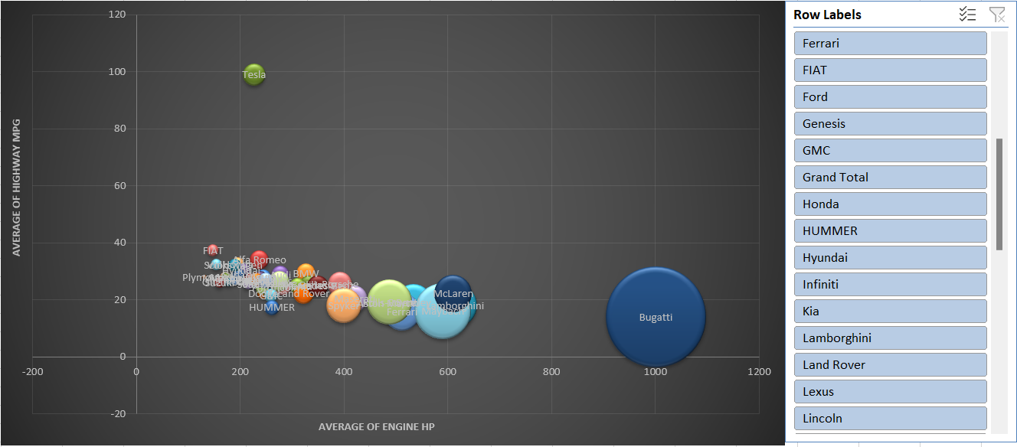
The analysis revealed significant variations in engine horsepower, fuel efficiency, and pricing across different automotive brands. For instance, BMW demonstrated a balanced approach, offering moderate engine power coupled with reasonable fuel economy at a mid-range price point. In contrast, Bugatti positioned itself as a luxury performance brand, prioritizing high horsepower and exclusive pricing. This analysis underscores the diverse strategies employed by automakers to cater to distinct market segments.

Slide 26

RESULT
MSRP Variation by Brand and Body Style
The analysis indicates a strong correlation between vehicle price (MSRP) and both brand and body style. Luxury brands such as Bugatti, Maybach, and Rolls-Royce command significantly higher price points compared to mainstream brands. Similarly, specific body styles, like SUVs and coupes, often carry premium price tags.
Engine Power and Pricing Correlation
Engine horsepower is a significant factor influencing vehicle price. Higher horsepower ratings are typically associated with increased vehicle cost, reflecting consumer willingness to pay a premium for enhanced engine performance.
Key Factors Influencing Car Pricing
The analysis highlights the interplay of various car features in determining overall pricing. Engine specifications, including cylinder count, horsepower, and fuel efficiency (both city and highway), significantly impact the final price. Vehicle style also plays a role in price differentiation. A comprehensive understanding of these factors is crucial for automakers to establish competitive pricing strategies and align product offerings with consumer preferences.
Fuel Efficiency Trends
The analysis reveals fluctuations in fuel efficiency across different body styles and model years. While there has been an overall improvement in fuel economy, distinct variations persist among vehicle body types. These insights empower consumers to make informed purchasing decisions by selecting models with superior fuel efficiency.

Slide 27

THANK YOU
EXCEL FILE FOR ANALYSIS TASK
EXCEL FILE FOR DASHBOARD TASK

